Slide 1
Unit 2 - Advanced Web Design
CS 102

Slide 3
Node Package Manager

Slide 4
NPM
Node is a great addition to the coding library and it gives us tons of useful tools… that we aren’t going to learn yet.
Instead we are going to use a different part of node called NPM or node package manager to install the libraries that we are using for this unit

Slide 5
Using install
Almost every library out there for js is downloadable from npm using the npm install command
Please go look for the CoffeeScript website and try to find the install command for that library

Slide 6
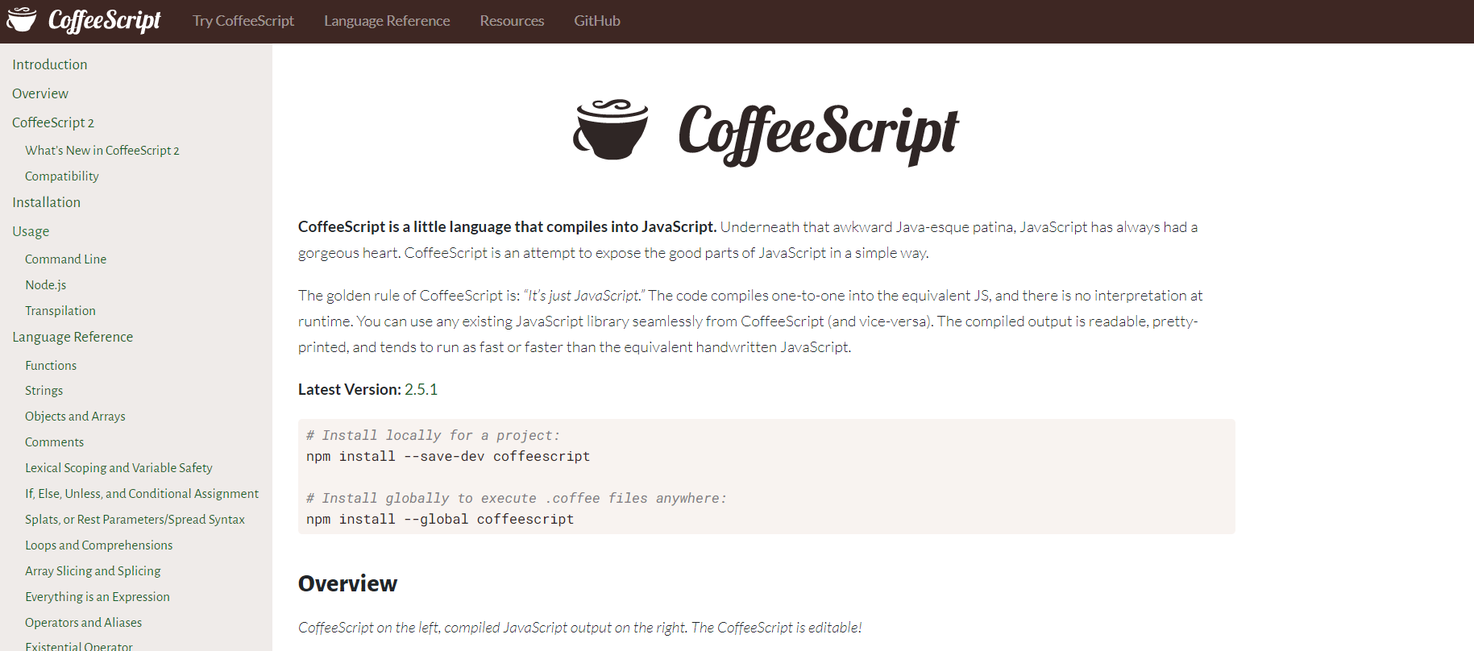

Slide 7
Installing Globally
If you read those 2 options you will see one is for a local project and one is global on your computer.
Depending on what you are using you may want to always have it available.
For instance coffeeScript is a shorter way to write js and you can use it for every project if you want by installing it globally

Slide 8
Install SASS
SASS is SCSS or CSS WITH SUPER POWERS
Please go to find the correct website, find the install code and install sass globally
Good Luck

Slide 9

REMEMBER ME
We are going to be using this a lot in the coming Unit and you will be using it even more in the future after this class
DO NOT FORGET NPM

Slide 10
SASS
CSS with super powers

Slide 11
SASS 101
SASS is exactly like what we have been doing in css but better.
We are able to nest styles, define variables easier and do inline calculations easier.

Slide 12
Creating .scss Files
Sass is just a type of scss but it is the most commonly used one and you are able to use both style.scss and style.sass
Almost everyone uses SCSS and we are too but if you are working alone don’t be afraid to try it out

Slide 13

Compiling SCSS
Websites can’t run on scss so we will need to compile it down to a css file in order to use it on the HTML
We are going to download an extension to do this.
Please look up

Slide 14
Follow on with these instructions
We are going to change some of the settings on the JSON to make it work nicely for us.

Slide 15
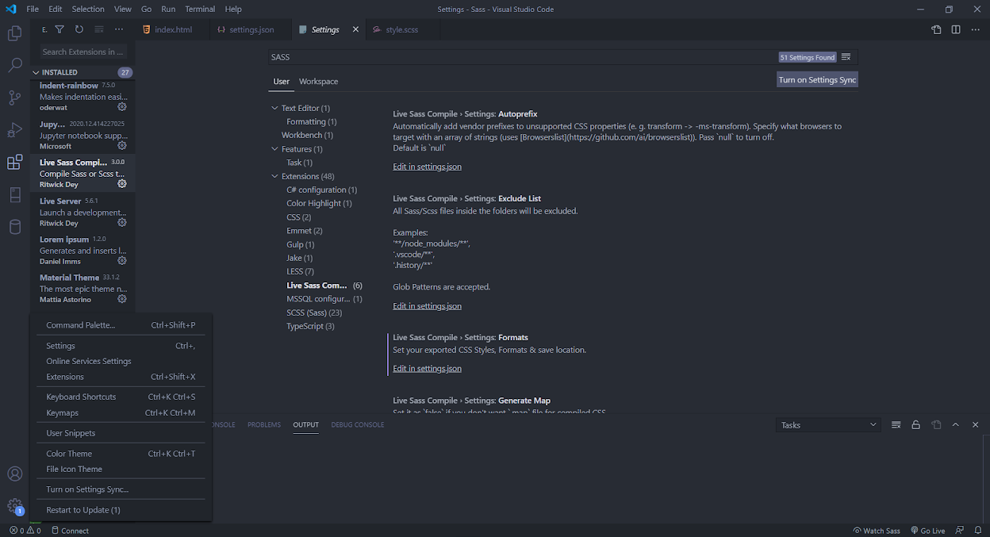
Settings
3.
4.
2.
5.
CLICK THIS
1.

Slide 16
Default Settings
Please look at the bottom of the settings JSON and make it look like this
{
"format": "expanded",
"extensionName": ".css",
"savePath": "/css"
},
{
"format": "compressed",
"extensionName": ".min.css",
"savePath": "/css"
},

Slide 17
Explanation
"format": "compressed",
"extensionName": ".min.css",
"savePath": "/css"
"format"
tells the compiler how to print out the css, compressed is minified and expanded is normal.
"extensionName"
Tells the compiler what the filename is style.css for example .min.css won’t run on the website but it will be how we tell them apart after the compiler
"savePath"
This is the folder that the css will be saved in. by saying “/” we are creating a new directory in the root folder

Slide 18
Now We Can Start
Please create your default index, style, and script files - But this time you will be creating style.scss
Don’t create .sass it’s similar but very different syntax

Slide 19
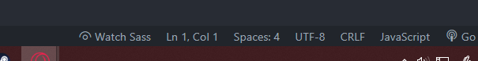
Watching SASS
As soon as the ‘Live SASS Compiler’ detects a new sass file it will create a small button on the bottom of your screen. Please click it

Slide 20
Variables
You could make variables before but they were kind of annoying and you needed to create them in root
Now you can make them anywhere using the dollar sign
$main-color: lightblue;
$font-stack: Helvetica, sans-serif;
$border-color: #333;

Slide 21
Nesting
We no longer have to declare each and every element on the way to the one that we want to edit
We can use nesting to refer to child elements (just like every other coding language) and the scss will compile into the proper references

Slide 22
Nesting
SCSS
nav {
ul {
margin: 0;
padding: 0;
list-style: none;
}
}
CSS
nav ul {
margin: 0;
padding: 0;
list-style: none;
}

Slide 23
Nesting Similar Properties
Some properties are very similar to one another for example padding-left, padding-right, padding-bottom, padding-top
SCSS can group these through nesting, making it easier for us

Slide 24
Nesting Similar Properties
padding: {
top: 5px;
right: 0px;
left: 50px;
}

Slide 25
& with Pseudo Classes
Creating pseudo classes (:active, :focus, :hover, etc) is also made easier by using the & in front of the pseudo class that you want to add

Slide 26
& with Pseudo Classes
.button {
&:visited {
background-color: red;
}
&:hover {
background-color: yellow;
}
&:active {
background-color: green;
}
}

Slide 27
Code Along:
Basic SASS Site

Slide 28
Partials
Another great tool in scss is the use of partials
You can make scss files and store them for later, then you can add them to another file by using import.
This can save you a lot of time if you always want the same look for your nav bar, then you can just import your navbar styles.

Slide 29
Partials
Partials are defined by using underscores before the name e.x. _partial.scss
If you want to import the scss you can use
@import '_partial.scss', '_another.scss'

Slide 30
Extension Breaking Error
If you try to import a file that does not exist your live sass compiler will break and you will need to restart VSC or click on the small box on the bottom right
WHEN THERE IS AN ERROR ON YOUR SCREEN READ THE ERROR, DON’T SPEED RUN THE ‘ok’s ON THE SCREEN AND THEN WONDER WHY

Slide 31
Creating _list.scss
Create a new folder called partials, this is where we are going to place all of our partials that we create for the page.
In that folder please create a file named _list.scss
IT MUST NAMED WITH AN UNDERSCORE that way the compiler knows that it will skip it while compiling, it will only be loaded when imported

Slide 32
Add to the HTML
<p>Section 1</p>
<ul>
<li>this</li>
<li>this</li>
<li>this</li>
</ul>
<button id="testing">Testing</button>
Please add the code on the left to both sections between the <p> tag and <button>

Slide 33
Creating your First Partial
Inside of the _list.scss please create a small amount of code that will be written just like the other scss file to style the list
ul{
background-color: black;
li{
color: yellow;
list-style: none;
padding-left: 10px;
}
}

Slide 34
Importing
Now that you have created the file you will be importing the file to make it run
It will compile and place the file exactly where you imported in the code look at the next two pages for examples

Slide 35
Importing
body {
@import "partials/_list.scss";
body ul {
background-color: black;
}
body ul li {
color: yellow;
list-style: none;
padding-left: 10px;
}

Slide 36
Importing
section {
@import "partials/_list.scss";
body section ul {
background-color: black;
}
body section ul li {
color: yellow;
list-style: none;
padding-left: 10px;
}

Slide 37
Update the Code Along HTML
<body>
<div>
<nav>
<ul>
<li>Home</li>
<li>About</li>
<li>Times</li>
<li>History</li>
</ul>
</nav>
</div>
Add this little bit of code to the HTML
Create a partial named _nav.scss

Slide 38
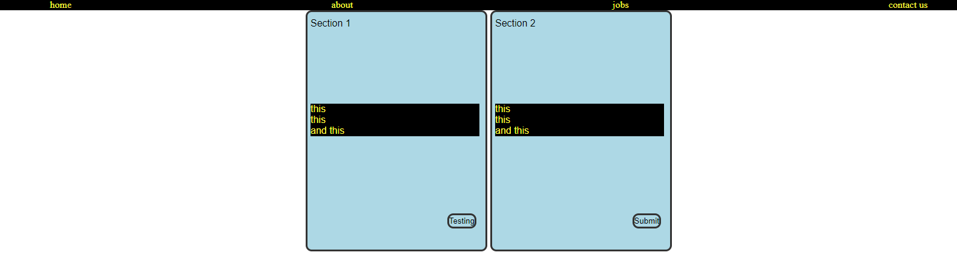
Finish your _nav.scss to create a nav bar that is above the 2 sections and horizontal.
Make sure it has the same styles as the other lists

Slide 39
Maps
We can create maps similar to objects in js except with parenthesis
They are set up with an object name and then corresponding key: value pairs
$font-weight: (
'small': 300,
'medium': 500,
'large': 700,
);

Slide 40
map-get
Using these can be a little tedious but it is good practice to get used to these for larger sites
To use these maps you need to use the map-get method in your scss
font-size: map-get($font-weight, small);
font-size: map-get($map: $font-weight, $key: small);

Slide 41
Functions
That map-get is kinda clunky and can be really annoying to use so most scss coders will use functions to fix that

Slide 42
Functions
To create a function in scss you use the @ function rule
@function weight($name){
@return map-get($font-weight, $name);
};
div{
font: weight(‘large’);

Slide 43
Mixins
These are kind of like partials but they are used in line and not in another file
You create a mixin using the @mixin rule and then you can call it by using the @include rule

Slide 44
Common Mixins
There are many bits of code that we need to type too often, for example to do flex we need to do:
display: flex;
justify-content: center;
align-items: center;
flex-direction: row;

Slide 45
Common Mixins
Mixins help with this because they allow us to write it one time and then @include it as many times as we want
@mixin flexCenter($direction) {
display: flex;
justify-content: center;
align-items: center;
flex-direction: $direction;
}
@include flexCenter(row);

Slide 46
Dark Theme Mixin
This is for coding only and will not update live on the page but here is an example of a mixin
@mixin theme($dark-theme: true) {
@if $dark-theme {
background: darken($main-color, 100%);
color: lighten($text-color, 100%);
}
}
.dark {
@include theme(true);
}

Slide 47
Dark Theme Mixin
Using the previous example you can now add a "dark” class to any element that you want in the HTML.
You can also see that we were able to add an if statement to the mixin, that way you can turn the dark theme on and off without erasing or commenting
.dark {
@include theme(false);
}
.dark {
@include theme(true);
}

Slide 48
Calculations
We are able to use calc() in css but in scss you can just do calculations without a method
width: 50% - 4%; // 46%

Slide 49
Extending a Container
If you want 2 things to have all the same properties as each other you can use the @extend rule and it will clone all of the same css properties, then you can modify what you want after it
#submit {
@extend #testing;
&:hover{background-color: black;}
}

Slide 50
Code Along:
Theme building Mixin

Slide 51
jQuery

Slide 52
jQuery 101
jQuery is a javascript library that allows us to navigate the DOM and implement animations and events easier than base JS.
jQuery is used very often and by thousands of companies its it important to know even if you move on to use react.

Slide 53
Properly installing JQuery
jQuery is not like SASS, it cannot be installed globally and still be expected to work.
Since jQuery is a library that is being executed on the client side when the page runs it won’t be able to run the site if it doesn’t have jQuery installed

Slide 54
CDN
In order to get these libraries out to everyone that needs it, we use a system called a CDN or Content Delivery Network
This is a simple way to import your library with a link and then it is downloaded on the user’s computer when they enter the site

Slide 55
Take a second to find the CDN link for jQuery.
Normally they are easier to find but this one is a little hidden.

Slide 56
Finding the CDN
In case you didn’t find it look up jQuery CDN on google and it’s the first link.
Click the:
jQuery Core 3.5.1 - uncompressed
and copy the js that pops up.

Slide 57
Let’s create a little playground for us to practice.
Time for a code along.

Slide 58
The jQuery Structure
jQuery is written very similar to js with a few key differences. They use $(); to grab values and then .methods to act on it.
$(document).ready();

Slide 59
Container for jQuery
Before you code any jQuery you need to wrap it in a container that will make sure the html is loaded
$(document).ready(function(){
});

Slide 60
Shorthand
This is done at the beginning of every jQuery so coders got tired of typing and now there is shorthand for it:
$(function () {});

Slide 61
Using jQuery
Here is an example of code that will hide a panel. I’ll explain it more on the next slide
$(function () {
$("#panel1").hide(1000);
});

Slide 62
jQuery
$(function () {
$("#panel1").hide(1000);
});
We access the panel using the id just like css but with a $()
The .hide is a jQuery method and (1000)a how long it will take to do this action in milliseconds.

Slide 63
Chaining
EVERYTHING in jQuery is done using methods like .hide
Because of this we can chain together as many methods in a row as we want :
$('#panel1').hide(1000).show(1000).hide(1000);

Slide 64
Toggling
Commands like show and hide will only work in one direction, meaning if it is already hidden it won’t show
This means you will need a button to show and another button to hide

Slide 65
Toggling
This is fixed by the addition of toggles.
Almost every action in jQuery has a toggle ability
If it is hidden then it will show and vise versa.
$("#panel1").toggle(1000);

Slide 66
Use google or the jQuery documentation to complete this and the following activities.

Slide 67
Add jQuery that will cause panel 1 to
go away over 3 seconds
and then
come back over 2 seconds

Slide 68
Add jQuery that will cause panel 2 to slowly change to
0% opacity over 1 second
and then back to
80% over 2 seconds

Slide 69
Add jQuery that will cause panel 3 to change by
collapsing upward over 1 second
and then
staying gone for 1 second
and then
coming back over 1.5 second

Slide 70
Add jQuery that will cause panel 4 to slowly change to
30% opacity over 1 second
and then
collapse over 2 seconds
and then become
expand over 2 seconds
and then
10% opacity 2 seconds
and then return to
100% opacity over 2 seconds

Slide 71
Changing CSS
Easier than ever with the CSS method.
By saying .css({}) the code will compile and do the style.property for you
$("#panel1").css({
color: 'red',
'font-weight': "900"
})

Slide 72
Changing HTML
Also very easy with the .html()
$("#button1").html("new Text")

Slide 73
Practice time:
Please update the play ground to recreate the image on the next slide using only jQuery

Slide 74
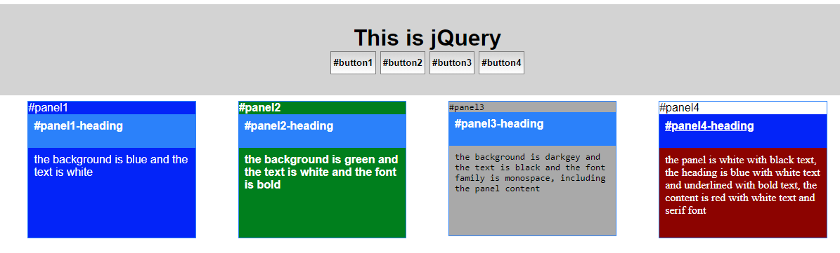
Practice Time

Slide 75
Event Binding
jQuery also helps with event listeners
We no longer need to type out .addEventListerner everytime we want to add one we can use .on
$("#button1").on("event", function(){})
//for example//
$("#button1").on("click", function(){
$('#panel1').fadeToggle(1000)
});

Slide 76
Event Binding
This works with any of the js events that you are used to using but now we can write .on instead of .addEventListener. (it’s a little easier)

Slide 77
Add events to your button 1 where the panel1 will fade out or in when the button is pressed

Slide 78
Create an event on button 2 that will cause the panel2 to hide and then reappear after a random amount of time between 1 and 6 seconds.

Slide 79
Create an event that will cause panel 3 and 4 to fade out when you mouse over button 3 and fade in when you mouse over button 4

Slide 80
Create a puzzle:
If you click button 1
panel 1 and 4 will toggle
If you click button 2
panel 2, 3, and 4 will toggle
If you click button 3
panel 1 and 3 will toggle
If you click button 4
panel 1 and 2 will toggle
The game is to turn them all off

Slide 81
Simplifying
You’ve heard that devs are lazy so here are a few ways to shorten up the code, you don’t want to type the same thing more than once

Slide 82
Selecting
Remember that the selectors for your jQuery are the exact same as the selectors for the CSS so if you want to add an event listener to every button you can do that
$('button').on('click', function(){})

Slide 83
Targeting
You can also add your own attributes to your html and store those in variables
Using this in combination with basic js can make your work easier (example on next slide)

Slide 84
Adding Custom Classes to the HTML
<div class="header">
<h1>This is jQuery</h1>
<button panelid='1' id="button1">#button1</button>
<button panelid='2' id="button2">#button2</button>
<button panelid='3' id="button3">#button3</button>
<button panelid='4' id="button4">#button4</button>
</div>

Slide 85
Using “this” in the jQuery
We add an event to every button that will find the panelid assigned to it using this
Then we combine that value with an id to choose the panel we want to toggle
$('button').on('click', function(){
let panelId = $(this).attr('panelid');
$('#panel'+panelId).toggle(1000);
})

Slide 86
Another point
You can also add more to your selectors jQuery
For instance if we want change the text in the panel heading we can do that by adding to it:

Slide 87
Example
$('button').on('click', function(){
let panelid = $(this).attr("panelid");
$('#panel'+panelid +' .panel-heading').html("this changed")
})

Slide 88
Make a fun way to follow instructions.
Use HTML and CSS to change the text of the buttons and panels and then use 1 event listener to bind everything together

Slide 89
DOM traversal
Many tutorials will include DOM traversal, Jobs will ask if you are a master of DOM and employers will require that you can access and change the elements of the DOM at will
Let’s learn more about DOM traversal

Slide 90
DOM (document object model)
We talked about this at the beginning of the year when we learned about HTML but to recap:
DOM is how your computer builds your site based on the HTML code that you write.
When you access your html from the jQuery or the css you are actually moving around the DOM that was created not the actual HTML

Slide 91
DOM
We have been using DOM traversal this whole time with IDs and Classes and all the selectors that we use in CSS.
But to be a master DOM walker you must learn how to move past the basics and into the obscure

Slide 92
Basics (for an idea)
The following are all basic DOM references that you have been using in jQuery
$('button')
$("#panel4-heading")
$(`.panel-heading`)
$(`.header div #button1`)

Slide 93
Upgrading the Playground
Please add the following to the bottom of the HTML
<div class="row">
<ul class="list">
<li>one</li>
<li>two</li>
<li>three</li>
<ul class="sublist">
<li>1</li>
<li>2</li>
<li>3</li>
</ul>
</ul>
</div>

Slide 94
Medium Level DOM (CSS)
We have used all of the following at some point, these are CSS pseudo classes and are therefore useable in the jQuery
div:first-of-type{}
div:nth-of-type(#){}
div:active{}
div:hover{}

Slide 95
Medium Level DOM (jQuery)
These are the same 4 selectors but they are written in jQuery.
$('div').first(); //or $('div:first');
$('div').eq(1); //or $('div:eq(1)');
//active doesn't exist in jQuery, use SCSS
$('div').hover() //or $('div:hover');

Slide 96
DOM Walker
To be a master DOM walker you must know how to traverse the most confusing DOMs and know the paths no matter the language you are using.

Slide 97
DOM Walker
Please do not think I am asking you to memorize them all, that's insane, but you can memorize the most common and then know where to find the rest. Speak of that….

Slide 98
I’m going to give you 2 minutes to find the documentation on jQuery Selectors and then tell write down how you would reference previous element to the one you are looking at

Slide 99
You are going to look at the following code and know that it all refers to the lists that we made. Please tell me what element(s) we are referring to by using the content

Slide 100
$('ul');
$('ul').eq(1);
$('ul').eq(1).children();
$('li').eq(4).parent().parent();
$('li').eq(5).prev();
$('li').eq(5).next();
$('li').first().next();

Slide 101
Practical Application
You could go through and give every item an id that is related to the button before it or, you can just use DOM to reference the next thing:
$('li').on('click',function(){
$(this).next().toggle(300);
})

Slide 102
Upgrade your SASS
Add this to your scss so that we can use it in an example
.highlight{
background-color: yellow;
}

Slide 103
Changing Classes
Editing classes in js is time consuming because you need to access the class as an array and then modify it
jQuery allows us to just use methods:
$('li').on('click', function(){
$(this).addClass('highlight')
$(this).siblings().removeClass('highlight');
})

Slide 104
Oh no! There was an error on the code the highlight doesn’t get removed from the list items above or below the target.
Using your new DOM skills please fix this issue

Slide 105
Upgrade the HTML
Please add 3 more of these .lists to your html inside of the .row div
You should have 4 total
<div class="row">
<ul class="list">
<li>one</li>
<li>two</li>
<li>three</li>
<ul class="sublist">
<li>1</li>
<li>2</li>
<li>3</li>
</ul>
</ul>
....
</div>

Slide 106
How can you find the nearest element with a certain selector?

Slide 107
How do you find every one of a certain selector? Like all list items (li)

Slide 108
How do you take a list of selectors (like ul) and then sort to find the one you want (like sublist)?

Slide 109
Code Along, creating a panel widget

Slide 110
Go to typing.io and create a free account.
Open Java Script jQuery and practice just 1 lesson. Please take a screenshot of the results page so I have a baseline

Slide 111
JS Timing Events

Slide 112
Students will learn how to use jQuery Events by completing a code along and a stopwatch

Slide 113
The Timing Events
There are only 2 and they work very similarly
setInterval(function(){}, delay)
This runs continuously after the delay
setTimeout(function(){}, delay)
This runs once after the day

Slide 114
setInterval
So the delay happens after everytime the function happens.
So if the function is an animation that takes 2000 ms and you set the delay to 2500 ms then there will be a 500 ms break between each one

Slide 115
Saving Your Intervals
You want to save your interval functions in a variable so that you can reference it later to stop the loop
let interval;
function startLoop(){
interval = setInterval(function(){}, 1000);
}

Slide 116
clearInterval
If you want your looping function to stop then you can clearInterval and remove the loop.
function stopLoop(){
clearInterval(interval);
}

Slide 117
Wrapping it all Together
Then you can use those function on events
let interval;
function startLoop(){
interval = setInterval(function(){}, 1000);
}
function stopLoop(){
clearInterval(interval);
}
$(`#button1`).on(`click`, startLoop());
$(`#button2`).on(`click`, stopLoop());

Slide 118
Image Slider Code Along

Slide 119
Create an interval that will happen every 3 seconds and randomize the background of the screen.

Slide 120
Create a loop that will add an image to the page on a loop until you click one of the images.
Clicking again will restart the loop

Slide 121
Create a stopwatch that counts the milliseconds,
Make sure you have 2 buttons
1 will start/stop the timer
1 will pause the time shown but still keep counting if the interval is running and it will clear the time if the interval is stopped

Slide 122
Bootstrap

Slide 123
Bootstrap 101
Bootstrap is a front-end framework for UI’s and themes
It is a mobile first framework, meaning we are going to be creating the site with a phone in mind

Slide 124
Bootstrap 102
This is responsive by default and does a lot of the work for you
Because classes are consistent between any site that uses it, devs are able to jump into other projects and get to work right away
Because this is the most popular framework it is very easy to find help, tutorials, and templates

Slide 125
Setup Bootstrap
Please go to the bootstrap main site and press the get started button
You will need both the CSS and JS CDN to get the work started

Slide 126
Documentation
If you take some time you can look around the documentation and see all of the styles that you can do.
Try to find the navbar, tables, buttons, and styles

Slide 127
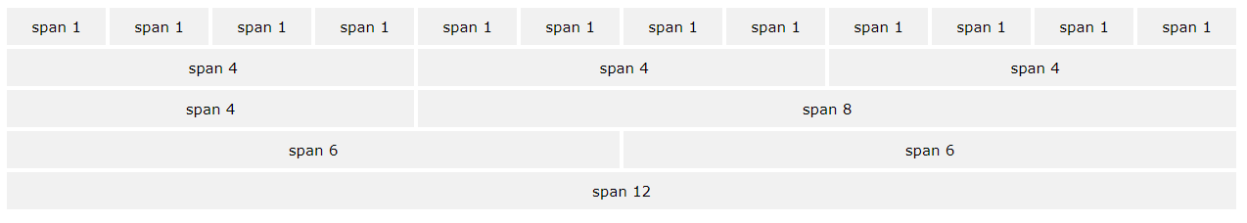
Bootstrap Grid System
Bootstrap works in a 12 column grid system and will autofill the cols for you

Slide 128
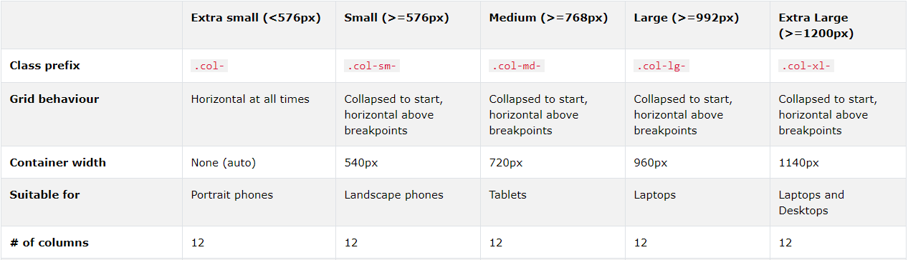
Grid Classes
Here is an table showing how to use the grid system, all of these are classes and can be used in the HTML

Slide 129
A Few Things You Should Know
Rows must be placed in a class="container" to span a specific width and a class="container-fluid" to span the entire width
Once you create your container you can create .rows and then .cols in that row for the layout
Columns are done by percent and size relative to the page

Slide 130
Bootstrap CDN
Bootstrap has 2 CDNs unlike most libraries because it also uses a distributed CSS that we use with the classes.
Got find both the CSS CDN and the JS CDN on the main bootstrap site

Slide 131
There are WAY too many classes for us to learn one at a time so lets start with a Code Along

